Slide 2
Unit 3: Control Structures (6hrs)
Introduction and types of control statements- sequential, branching, and looping statements
Branching statements- simple if statement, if-else, nested if. if-else-if ladder and switch statements
Looping statements- for loop, while loop, do-while loop, nested loop
The break, continue, and goto statements

Slide 3
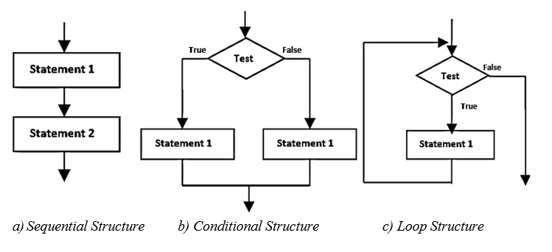
3.1 Control Structures
Control structure refers to the structure of program that may be sequential or conditional or iterative.

Slide 4
3.2 Control Statements
The statement that alters the flow of execution of the program is known as control statement.
These control statements divert the control flow from one point to another point in a program.
There are three types of control statements in C-programming.
Branching Statement
Loop statements
Jumping statements

Slide 5
3.2.1 Branching Statements (Decision Making)
Such statements checks condition if TRUE or FALSE and then branch the executions
If statements
Switch statements
Ternary statements

Slide 6
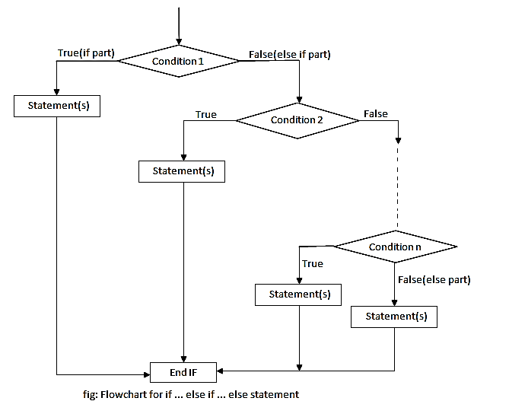
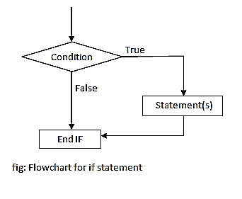
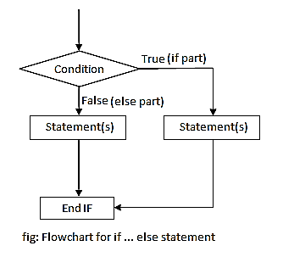
i) If statements
Simple if statement
if-else statement
if-else if- else statement

Slide 7
i) If statements
Simple if statement
if-else statement
if (condition 1) statement 1; else if (condition 2) statement 2; else if (condition 3) statement 3; else last statement;
if (test condition) { //statement 1; } else { //statement 2; }
if-else if-else
statement
if(condition)
{
//code to be executed
}

Slide 8
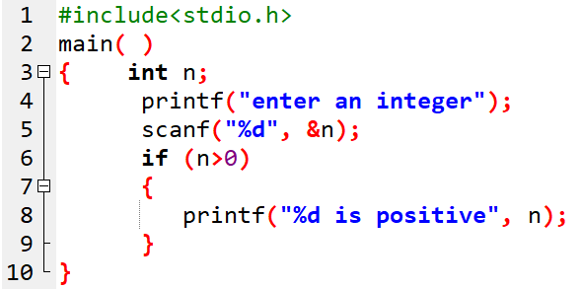

Prog 1. WAP to enter an integer and check if positive.

Slide 9
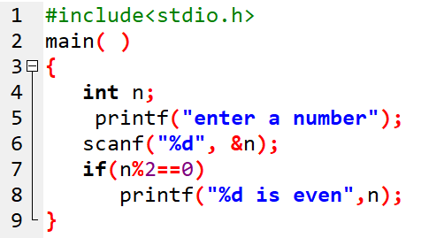

Prog 2. WAP to enter a number and check if it is even.

Slide 10
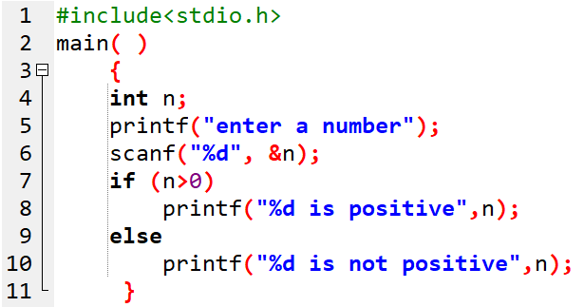


Prog 3. WAP to enter a number and check if it is positive or not positive.

Slide 11
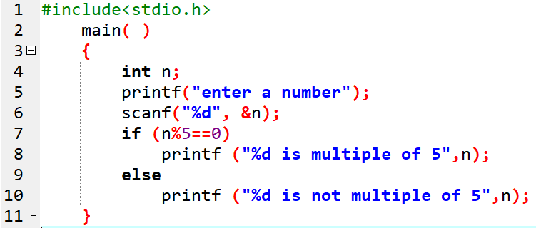

Prog 4. WAP to enter a number and check if it is multiple of 5 or not.

Slide 12
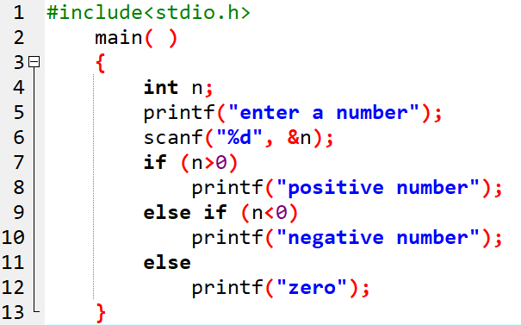



Prog 5. WAP to enter a number and check if positive, negative or zero.

Slide 13
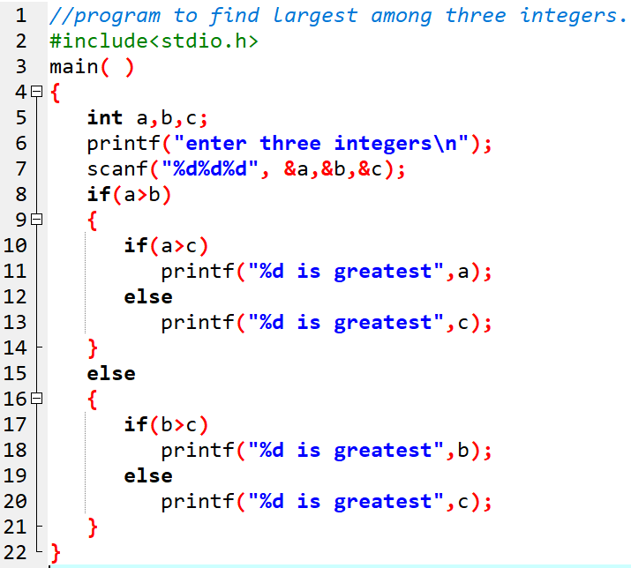
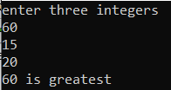
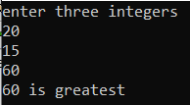
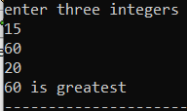
Prog 6. WAP to find the largest among three input integers.

Slide 14
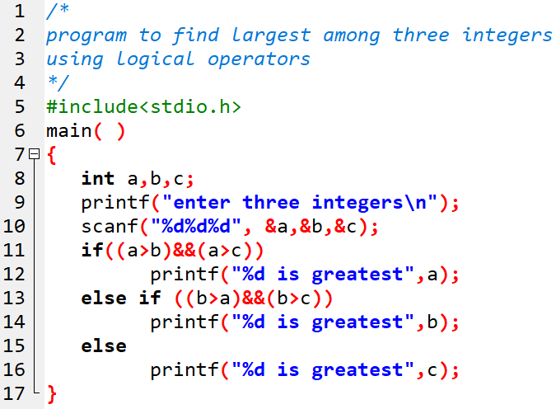
Prog 7. Using logical operators, WAP to find the greatest among three input numbers.

Slide 15
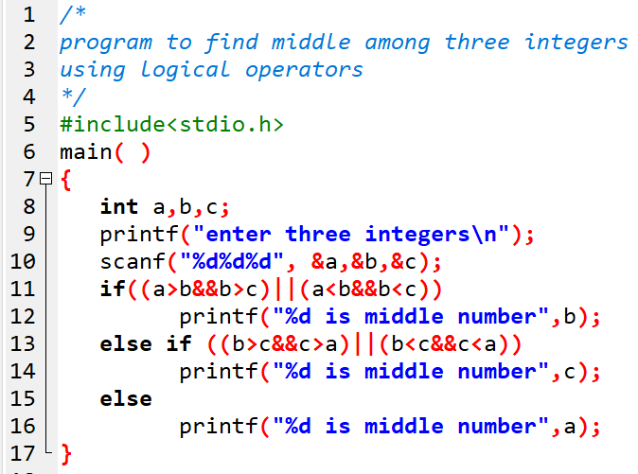
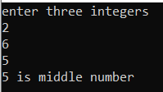
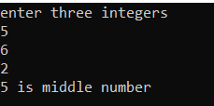
Prog 8. Using logical operators, WAP to find the middle one among three input numbers.

Slide 16
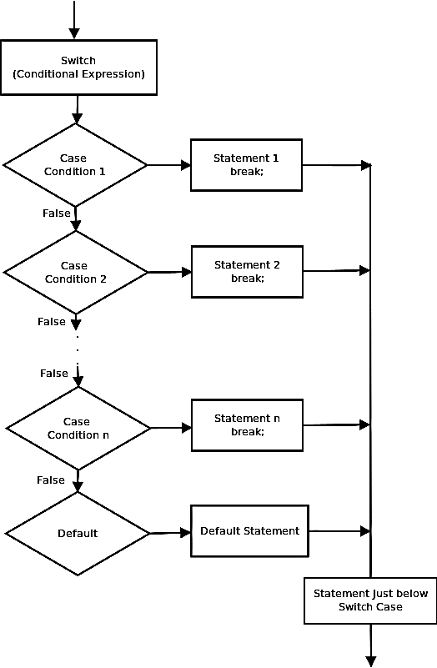
ii) Switch statement
Similar to if-else ladder
Tests for equality
Syntax: switch (expression) { case value 1: statement block; break; case value 2: statement block; break; . . case value N: statement block; break; default: statement block; }

Slide 17
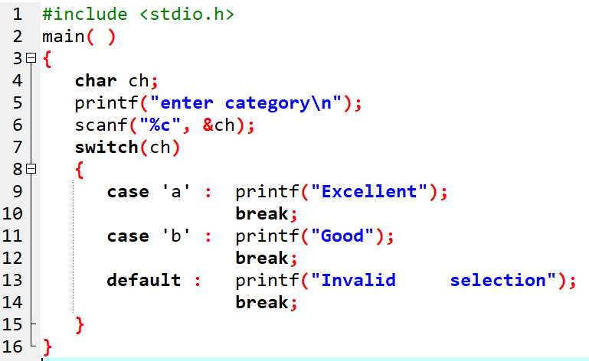

Prog 9. WAP to enter a character and display either excellent or good using switch statement.

Slide 18
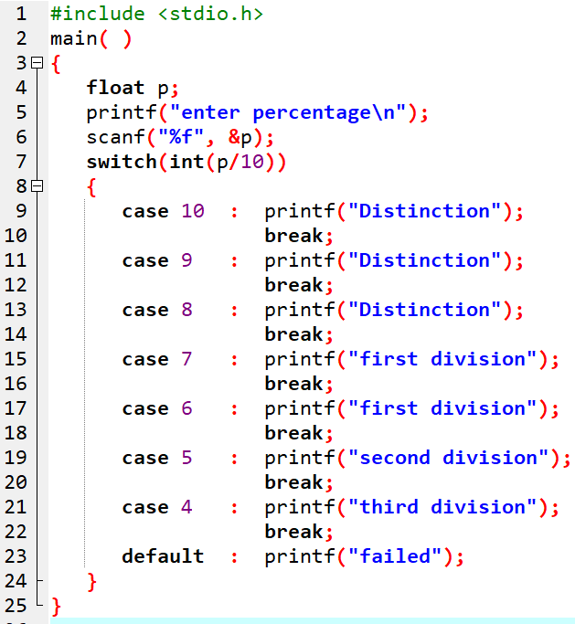

Prog 10. WAP to enter percentage of a student and display his division.

Slide 19
Assignment
WAP to display the following menu:
Menu
Conversion of ASCII code to char
To find the sum of n natural numbers
To find the greatest among two entered numbers.
Exit from program
and to perform task as per user’s choice repeatedly until his/her Choice is to exit.

Slide 20
iii) Ternary statement
uses ternary operators
Syntax:-
Conditional expression ? exp 1: exp 2;
If conditional expression is True:- exp 1 is evaluated.
If conditional expression is False:- exp 2 is evaluated.

Slide 21
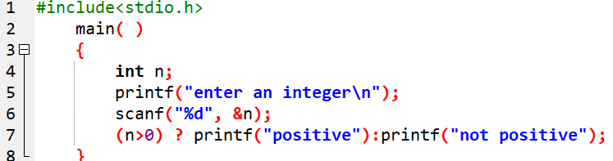

Prog 11. WAP to input an integer and check if positive or not. Make use of conditional operator.

Slide 22
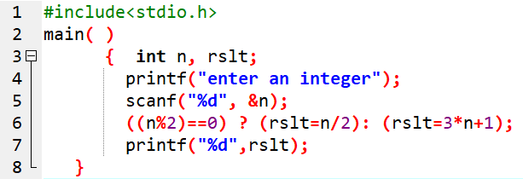

Prog 12. Using conditional operator, WAP to enter an integer and display the result as calculated below: Even:-n/2 Odd:-3n+1

Slide 23
End of Lecture 7

Slide 24
Looping Statements

